Slide 1

React JS
What’s New?
Represented by :Victory MBENZE

Slide 2
PLAN
PLAN
GOALS
NEWS
DEMO
GOALS FOR UPDATING TO REACT v19
NEWS IN REACTJS
v19
DEMO

Slide 3
PLAN
GOALS
NEWS
DEMO
Goals for updating to React 19
GOALS
For updating to React v19
Notes:
or as known bridge based native module system

Slide 4
PLAN
GOALS
NEWS
DEMO
Goals for updating to React 19
With version 19, React introduces revolutionary features that simplify development, optimize performance, and improve user experience, while reducing code complexity
Improve performance with Server Components
Strengthen the user experience.
Facilitate the management of asynchronous
Simplify the management of complex states
Increase productivity

Slide 5
PLAN
GOALS
NEWS
DEMO
New React v19
NEW
React v19

Slide 6
PLAN
GOALS
NEWS
DEMO
News React v19
What News?
News Hooks
Server Components
API

Slide 7
PLAN
GOALS
NEWS
DEMO
New React v19
React 19 introduces several new hooks designed to simplify development and improve application performance, among which we will examine the most relevant and impactful for developers.
useActionsState
useTransition
useOptimistic

Slide 8
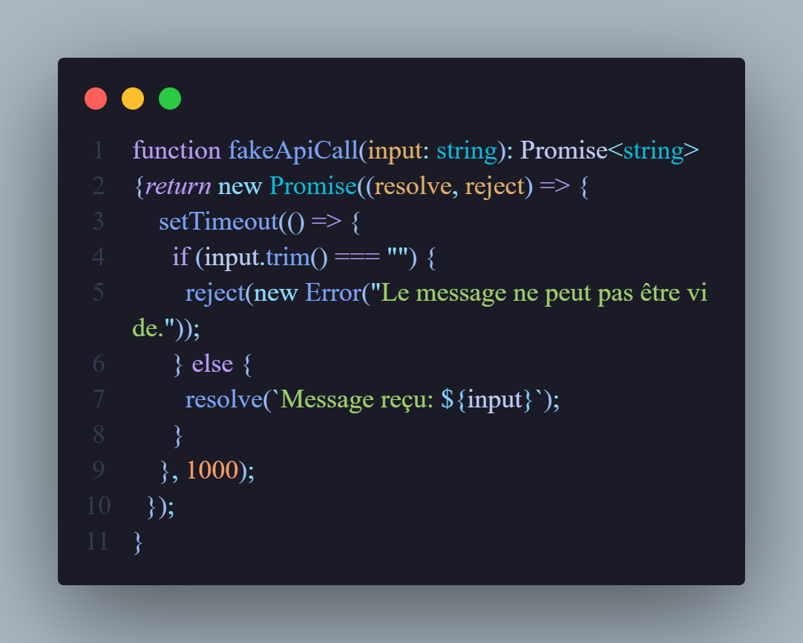
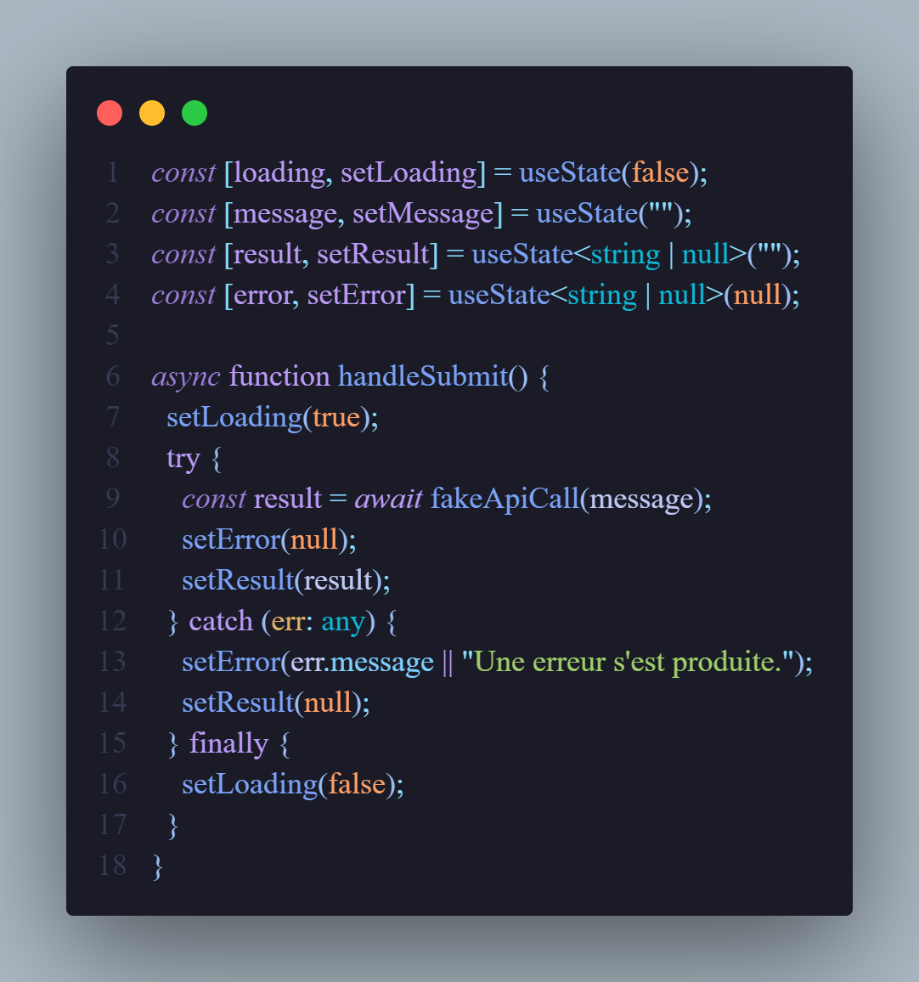
PLAN
GOALS
NEWS
DEMO
News React v19
useActionState: Simplify the management of data mutations. They automatically handle wait states, errors, and optimistic updates, thereby reducing code complexity.
Old React v18

Slide 9
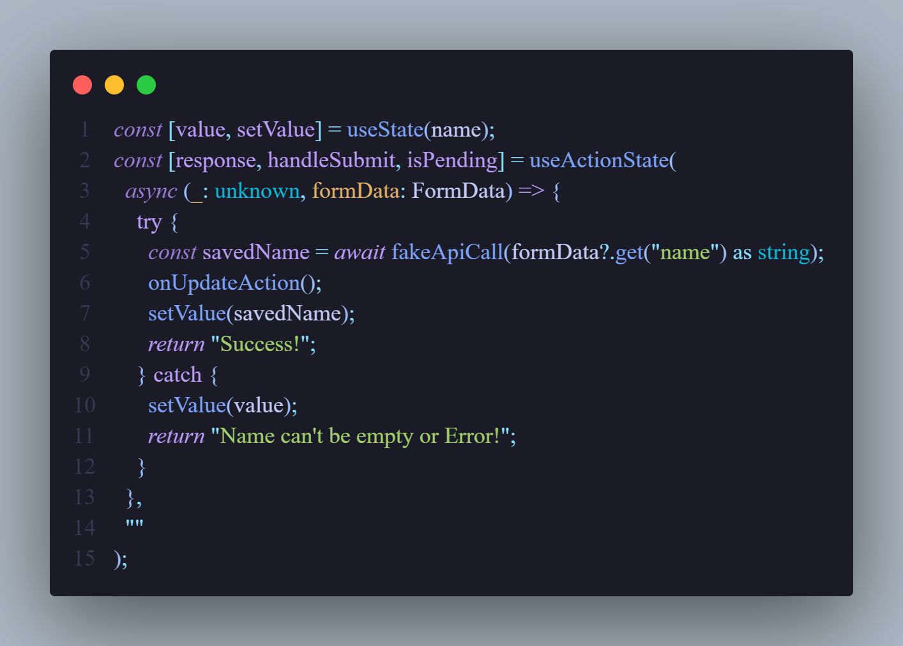
PLAN
GOALS
NEWS
DEMO
News React v19

Slide 10
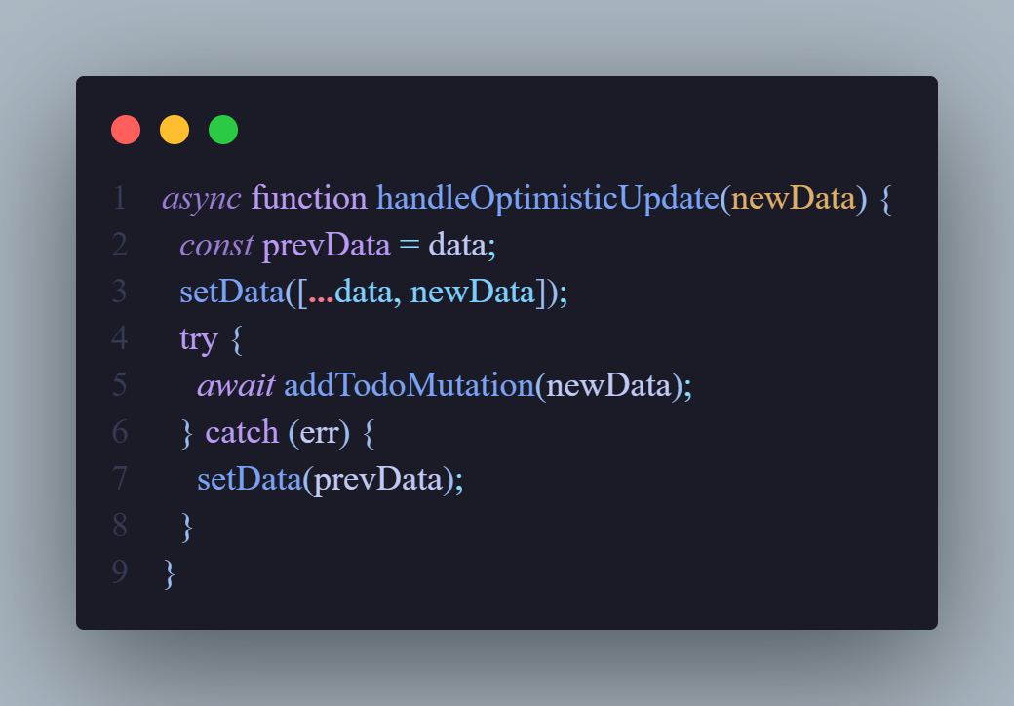
PLAN
GOALS
NEWS
DEMO
News React v19
useOptimistic: This Hook facilitates the management of optimistic updates to improve the fluidity of interfaces.
Old React v18

Slide 11
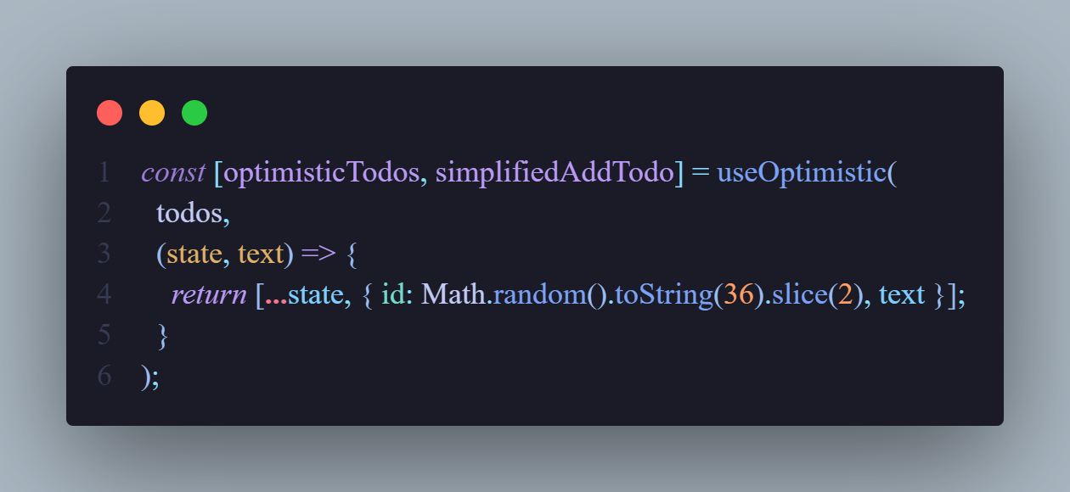
PLAN
GOALS
NEWS
DEMO
News React v19

Slide 12
PLAN
GOALS
NEWS
DEMO
New React v19
React v19 introduce new API called use designed to simplify asynchronous data management and improve the developer experience. It allows you to wait for Promises directly in functional components without having to manually manage additional states like loading or errors. This makes the code clearer and reduces the need to write complex hooks.
use

Slide 13
PLAN
GOALS
NEWS
DEMO
News React v19
Automatic waiting for promises:
you can call an asynchronous function or use a promise directly in a component. React waits for this promise to resolve or reject before continuing with rendering.
Integrated management of loading states and errors
is used with a promise, React automatically handles intermediate states, like waiting for the promise to resolve or catching errors on failure.
This is a game-changer for animations, gestures, and real-time updates where performance is critical
Sequential Rendering and Elimination of Intermediate Hooks
React ensures sequential rendering where the necessary data is ready before the component is rendered. This avoids the flashes of empty states often observed with traditional approaches.
reduces the need to write hooks like useEffect combined with useState to handle asynchronous data, thereby simplifying component structure

Slide 14
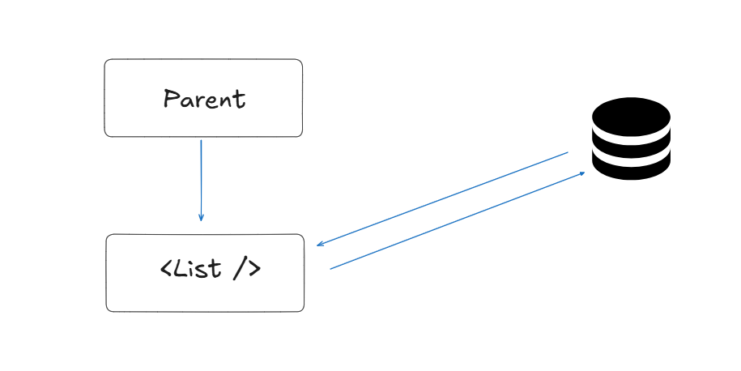
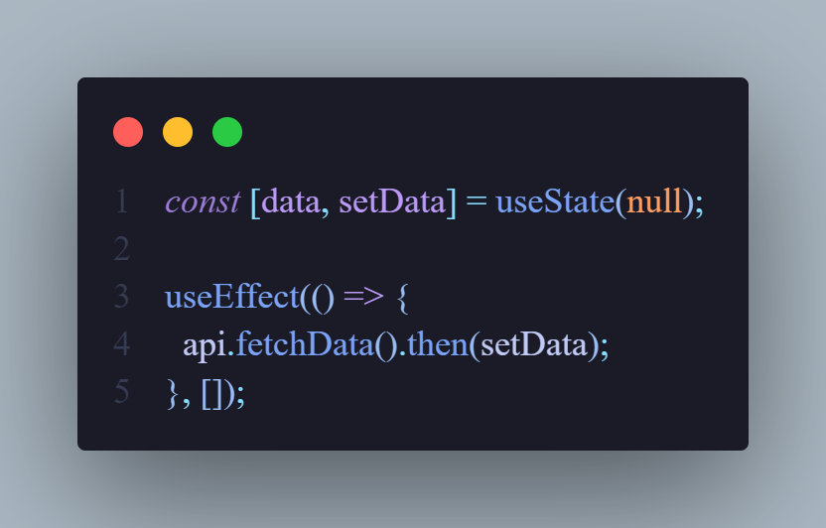
PLAN
GOALS
NEWS
DEMO
News React v19
Old React v18

Slide 15
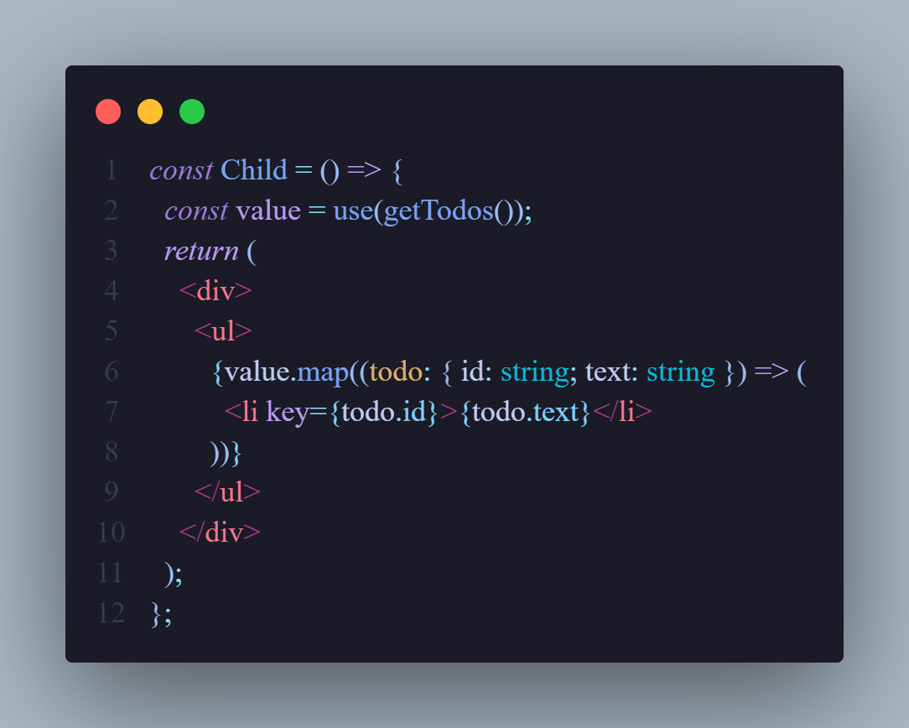
PLAN
GOALS
NEWS
DEMO
News React v19

Slide 16
PLAN
GOALS
NEWS
DEMO
New React v19
represent a new way to manage server-side logic directly from React components. They allow you to move certain parts of business logic or asynchronous operations to the server while remaining tightly integrated with React components.
Server Actions

Slide 17
PLAN
GOALS
NEWS
DEMO
News React v19
Functions performed on the server side
Server Actions are functions marked as specifically executed on the server. They are triggered from the client, but their logic is executed on the server side, which allows you to benefit from the performance and security inherent to the server.
Architectural simplification
Heavy calculations and complex processing are delegated to the server, reducing the load on client devices..
No need to configure separate REST or GraphQL APIs to manage server logic. Everything is centralized in the React application.
Smooth user experience and increased security
Sensitive data or critical logic remains server-side, reducing the risk of exposure.
Server Actions allow you to update the user interface in real time with the results of server operations, without the need to write complex code to manage intermediate states.

Slide 18
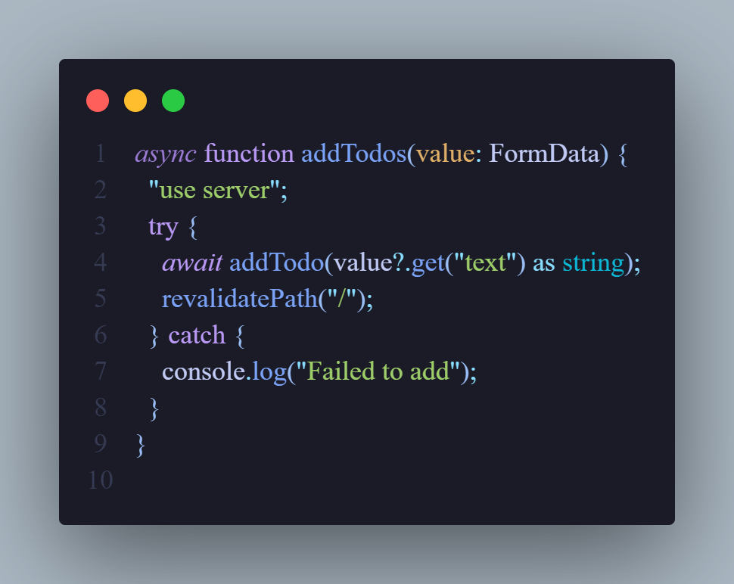
PLAN
GOALS
NEWS
DEMO
News React v19

Slide 19

PLAN
GOALS
NEWS
DEMO
DEMO
DEMO

Slide 20
PLAN
GOALS
NEWS
DEMO
Conclusion
Conclusion

Slide 21
Thank
you

